Slide 1

Piracy Why and How
Hamtalk (Karaj)
29 Oct 2023
Nikan Doosti

Slide 2
Let’s play a game
I show you the thumbnail of a video
It has the following information:
Release year
Number of views
Number of likes
You should guess if the video is appreciated by the community
I show you the dislikes as a (good) metric of community feedback

Slide 3
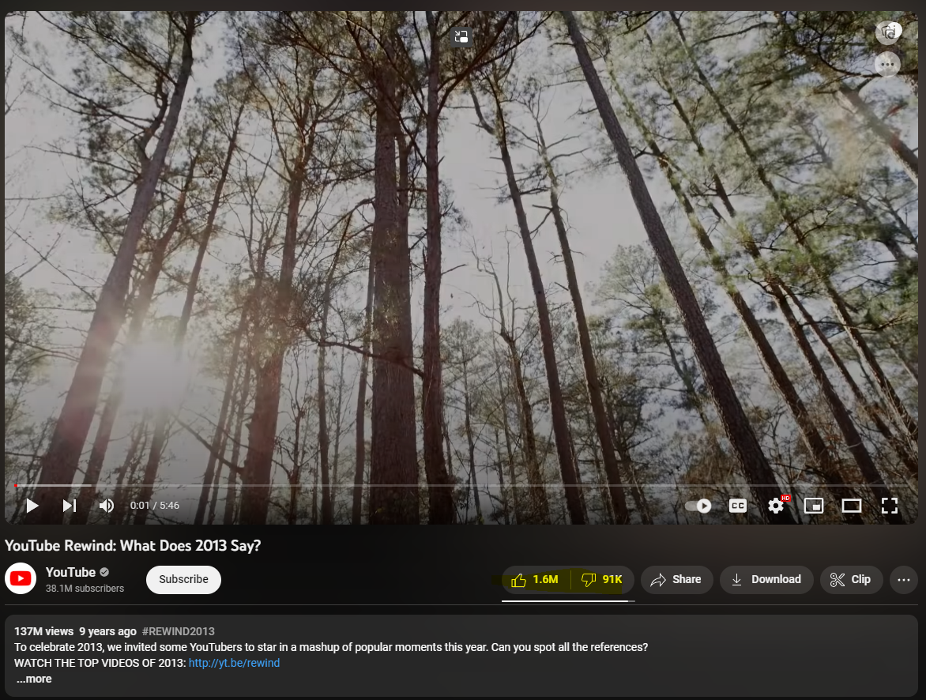
?

Slide 4

?

Slide 5
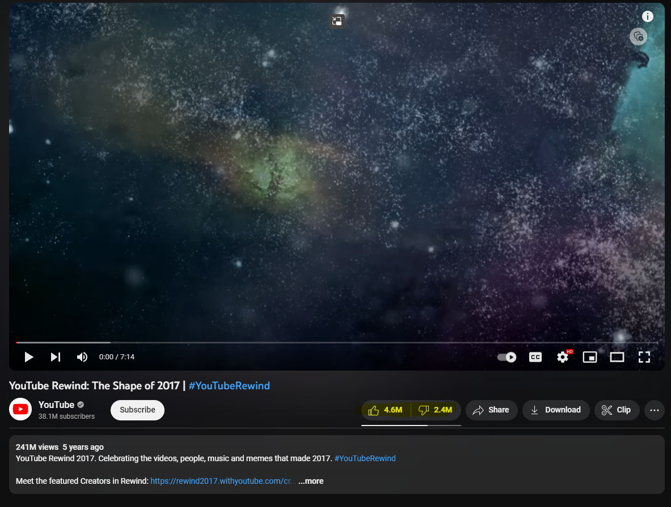
?

Slide 6
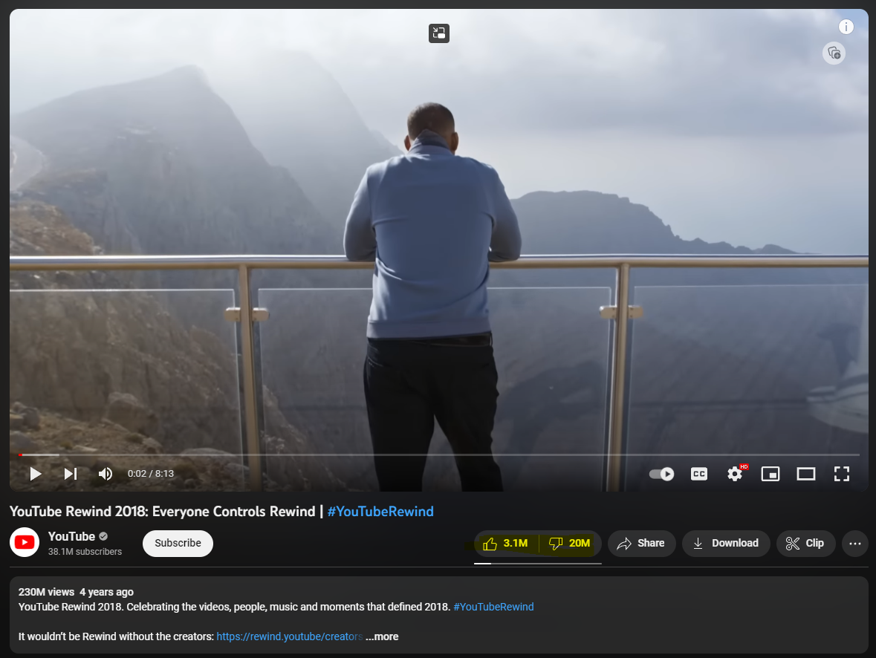
?

Slide 7
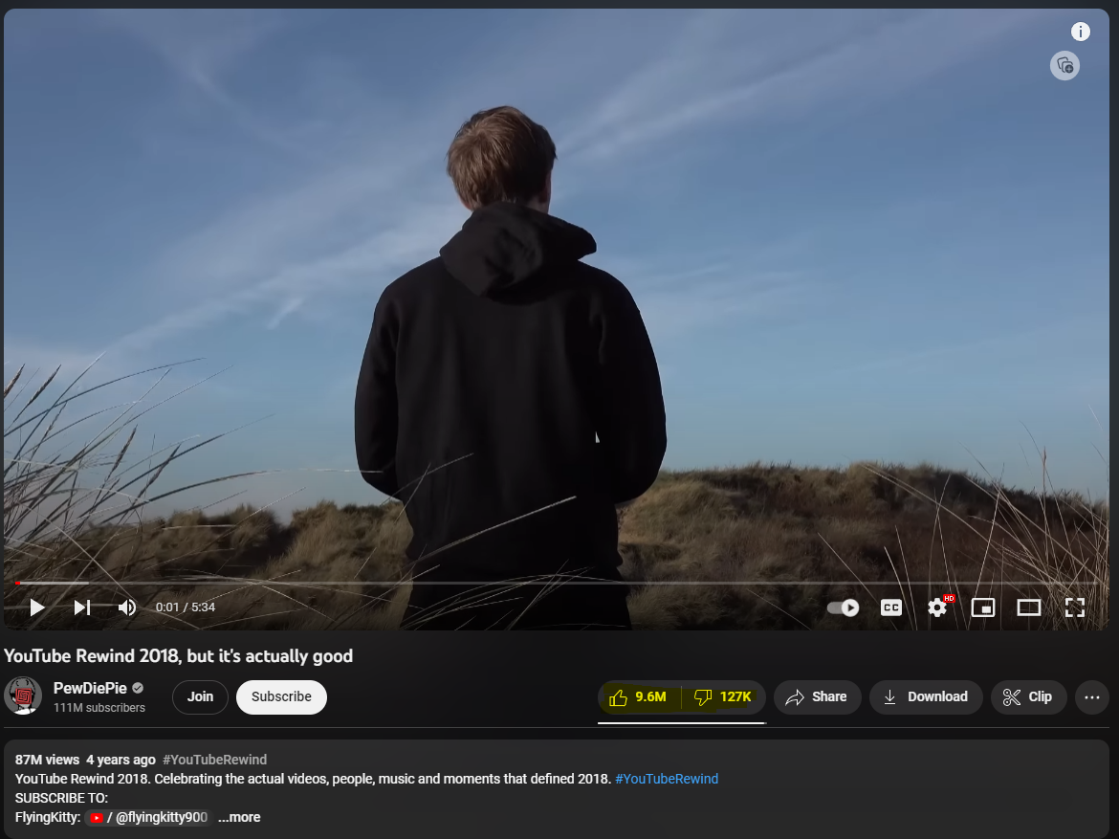
?

Slide 8
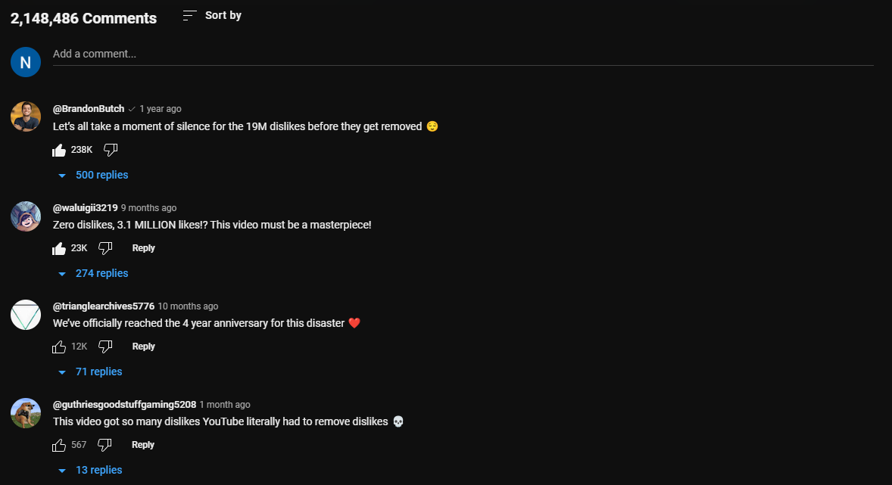
It actually happened!!!

Slide 9
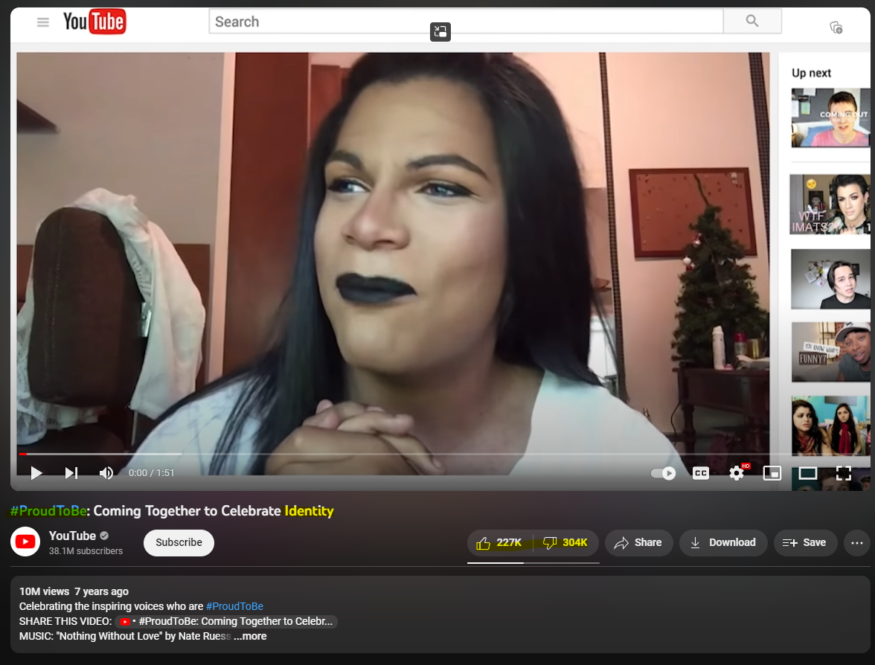
?

Slide 10
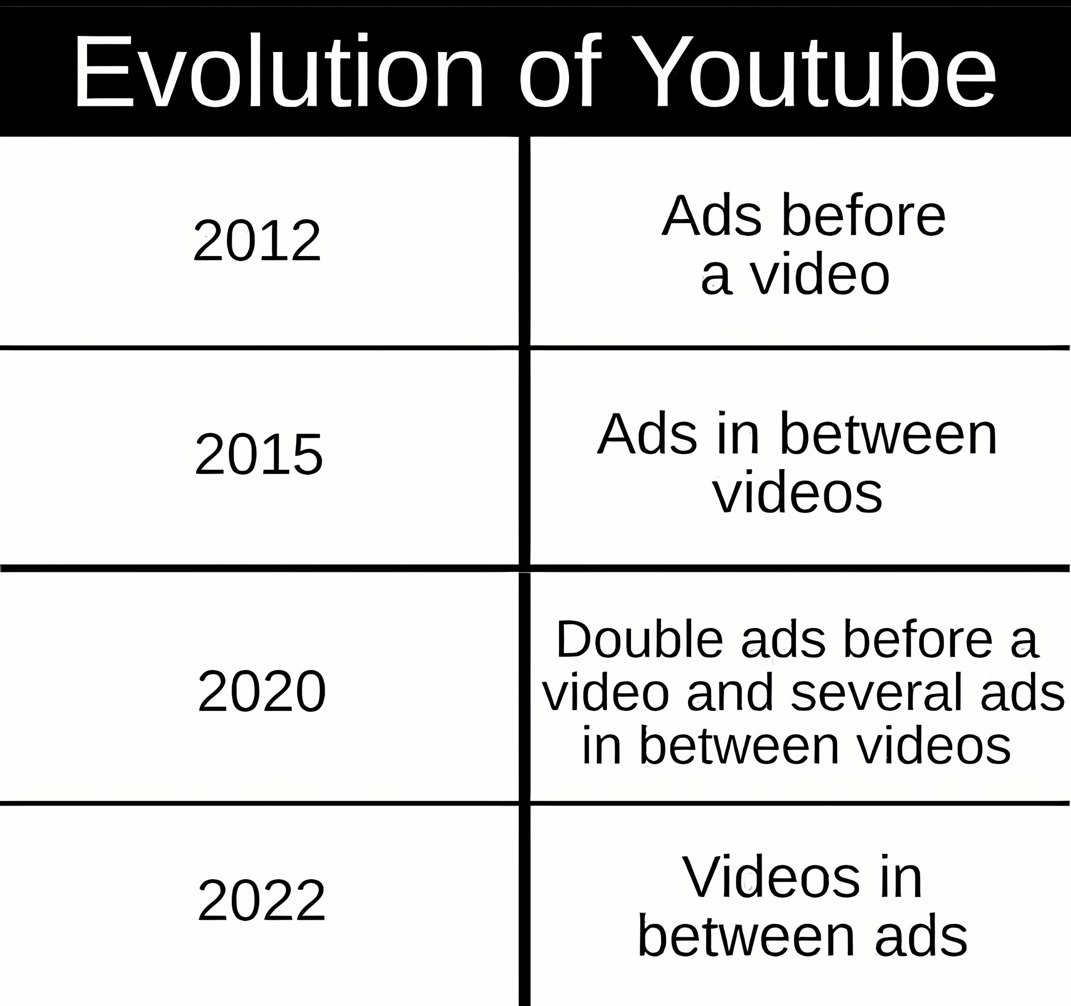

Slide 11

Free TV on Antenna
Has Commercials
Cable offers TV without Commercials (paid)
Cable starts airing commercials
Cable charges extra for bonus channels (HBO)
Cable starts packages (only one item is desired)

Slide 12
Streaming comes out
Offers free TV with commercials
Offers paid plans without commercials
Subscriptions become mandatory
Ads are shown even on paid plans
Exclusives on each service, requiring separate plans

Slide 13
Free TV on Antenna
Has Commercials
Cable offers TV without Commercials (paid)
Cable starts airing commercials
Cable charges extra for bonus channels (HBO)
Cable starts packages (only one item is desired)
Streaming comes out
Offers free TV with commercials
Offers paid plans without commercials
Subscriptions become mandatory
Ads are shown even on paid plans
Exclusives on each service, requiring separate plans

Slide 14
How about science?
You might think this is just about the entertainment companies.
How about scientific publications? Books? Conferences? Journals?

Slide 15
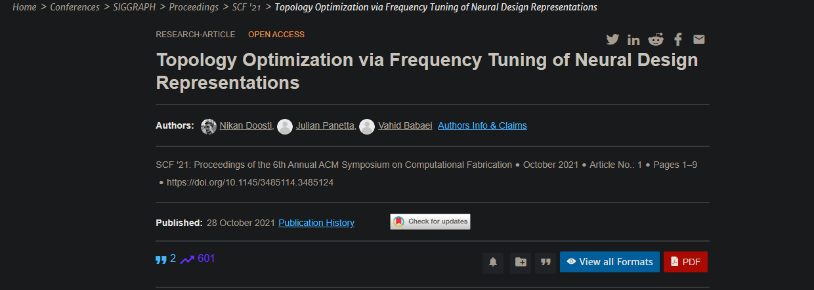
Academic Publication
I have published a paper
All paid by the tax money (hosted in Germany) and my own
In total, from zero to publication, cost around $8000
When I wanted to publish this, I had the following options:
Free: have no rights, not me not the public, no one
Free*: Have some rights, but behind the paywall; $15 for the access
Paid: have some rights, and open access for the public; $400 one-time fee

Slide 16
The Problem

Slide 17
Wide spread adoption
Features
“premium” edition
“standard” edition
User standard
Time
IT IS ALL THE SAME
As long as the publishing company is the copyright holder rather than the creator
Solution
Notes:
For a mega-corporation like Microsoft this makes perfect sense. Not only is the education market immense and juicy in itself, but the prospect of shaping students into future workers, managers, and entrepreneurs that have literally and formally learnt to depend exclusively on their products must be irresistible.

Slide 18
Piracy can't be stealing, if paying for it isn't owning.

Slide 19
How does it work?

Slide 20
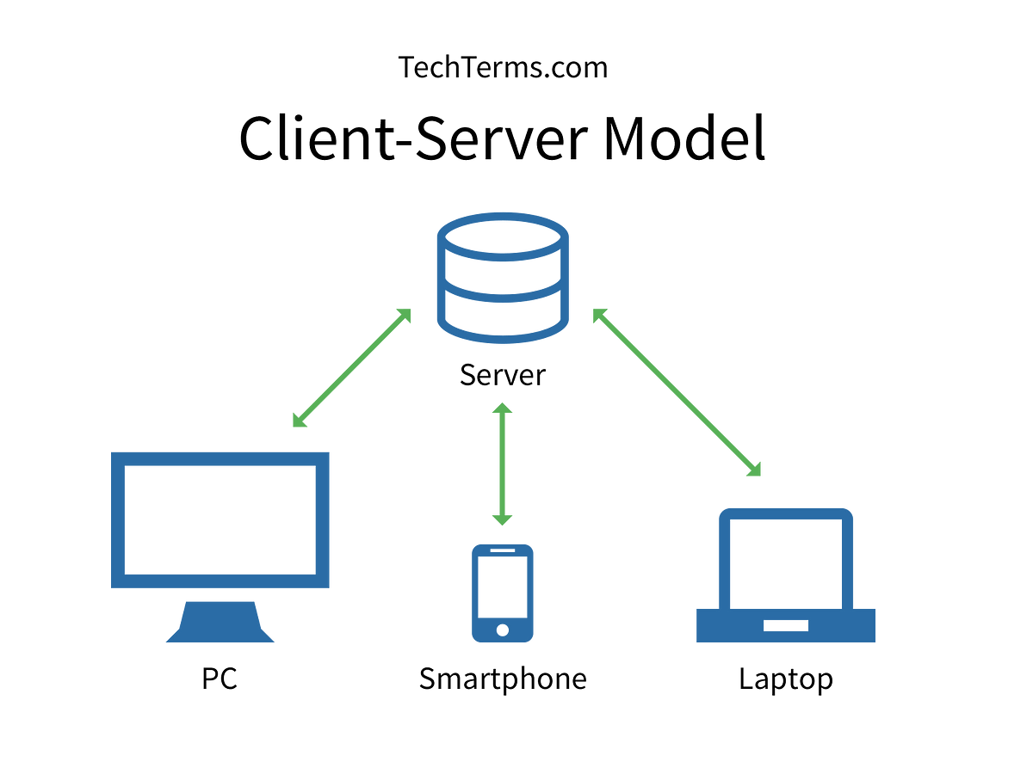

Slide 21
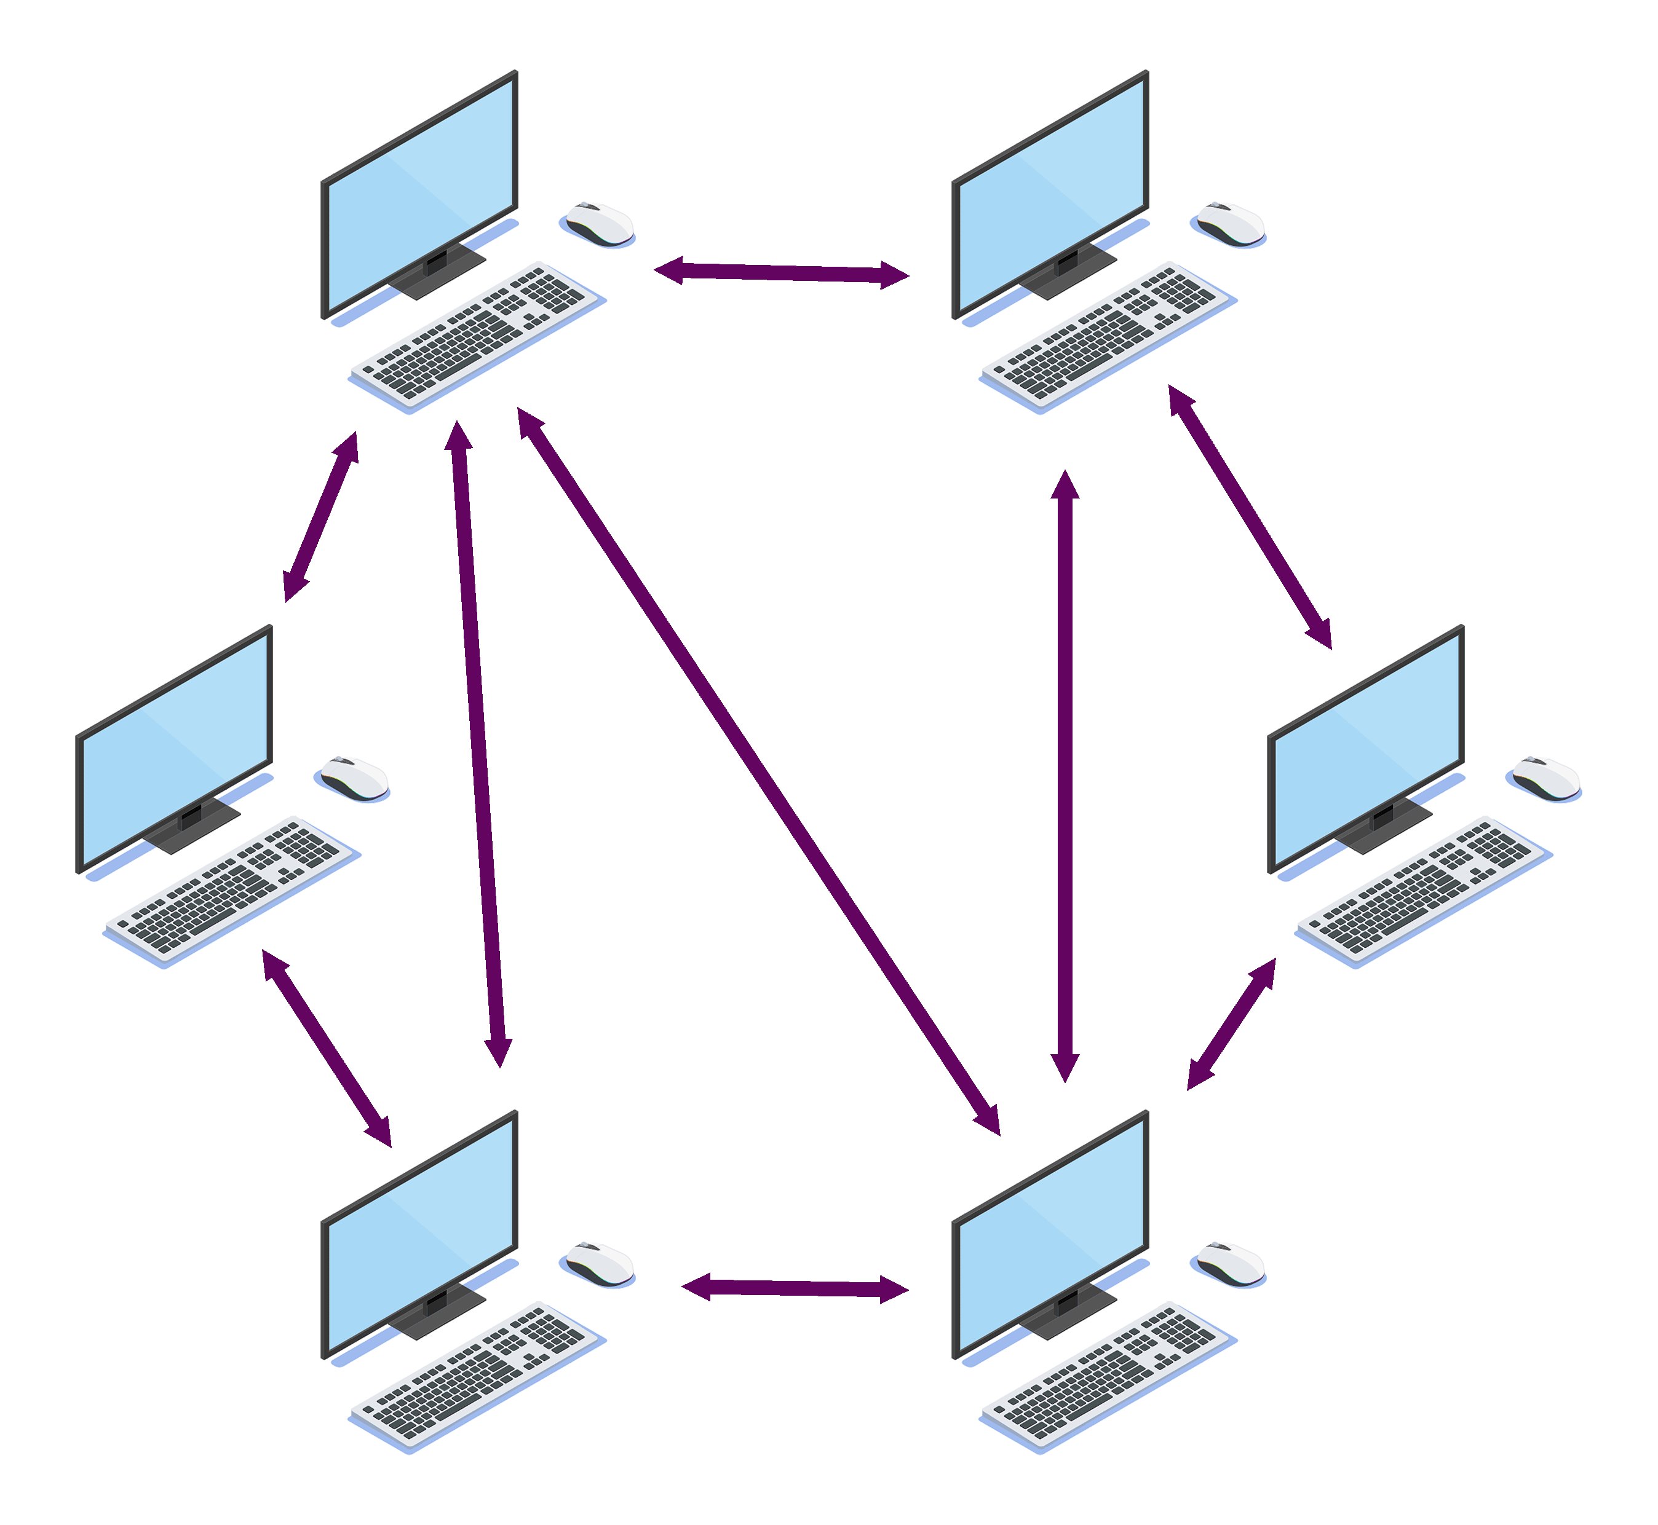
Peer-to-Peer Model

Slide 22
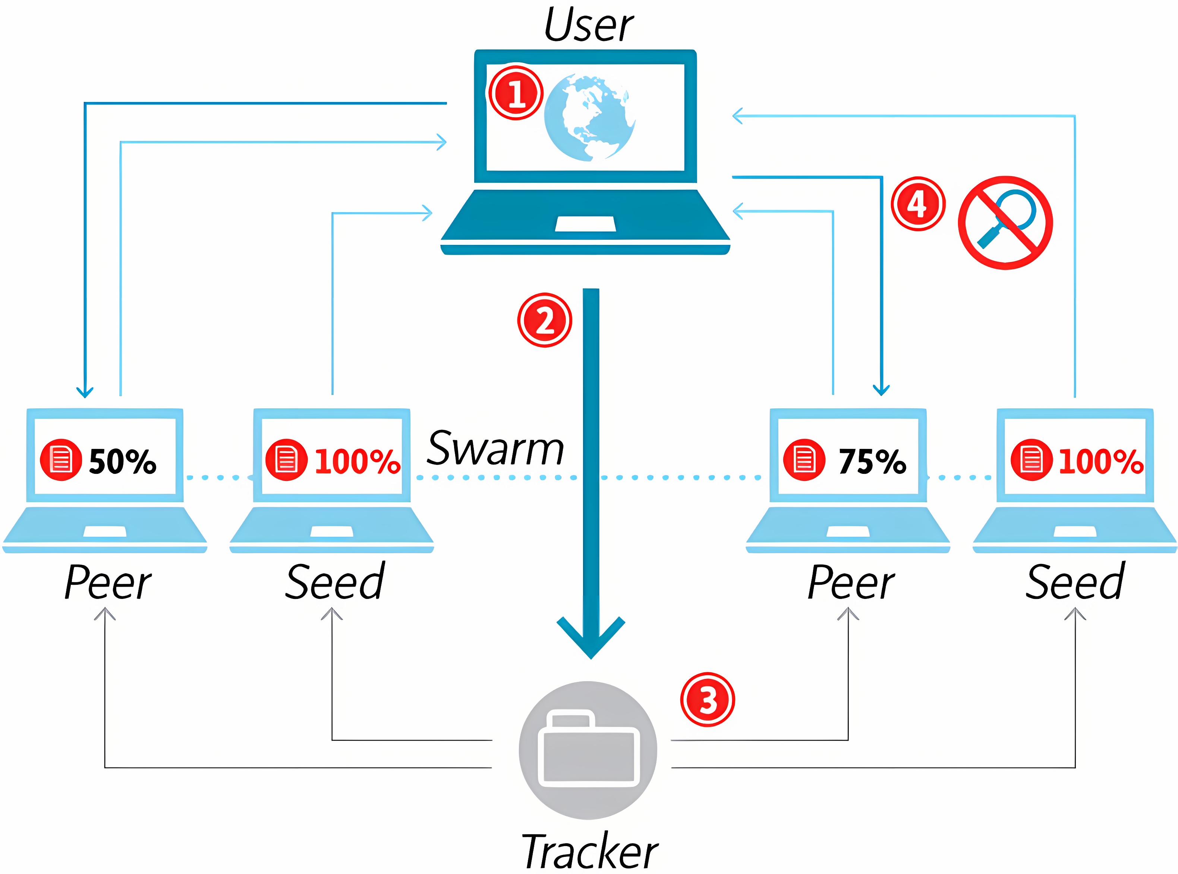
Torrenting

Slide 23
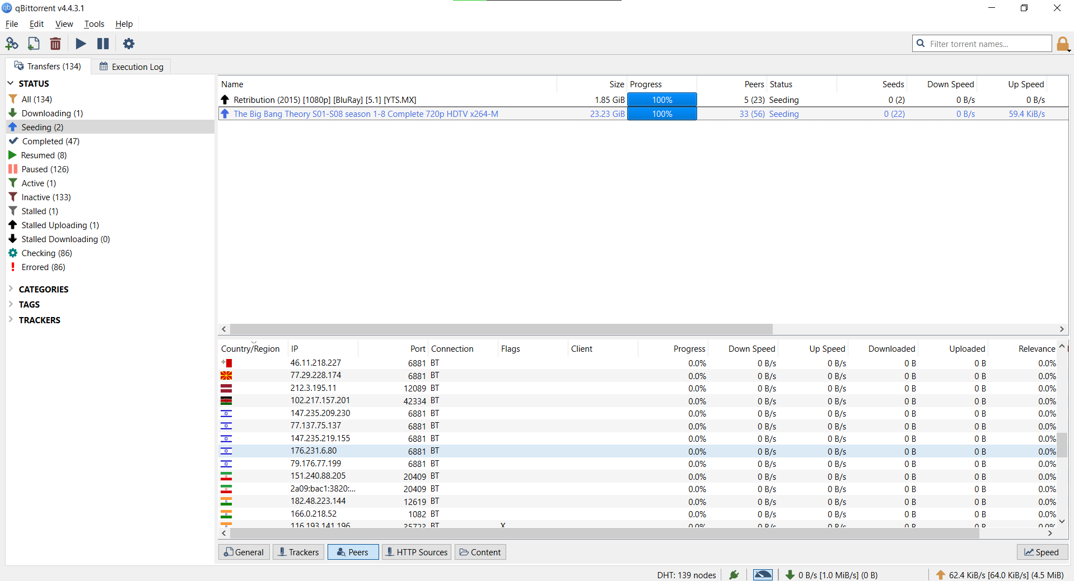

Slide 24
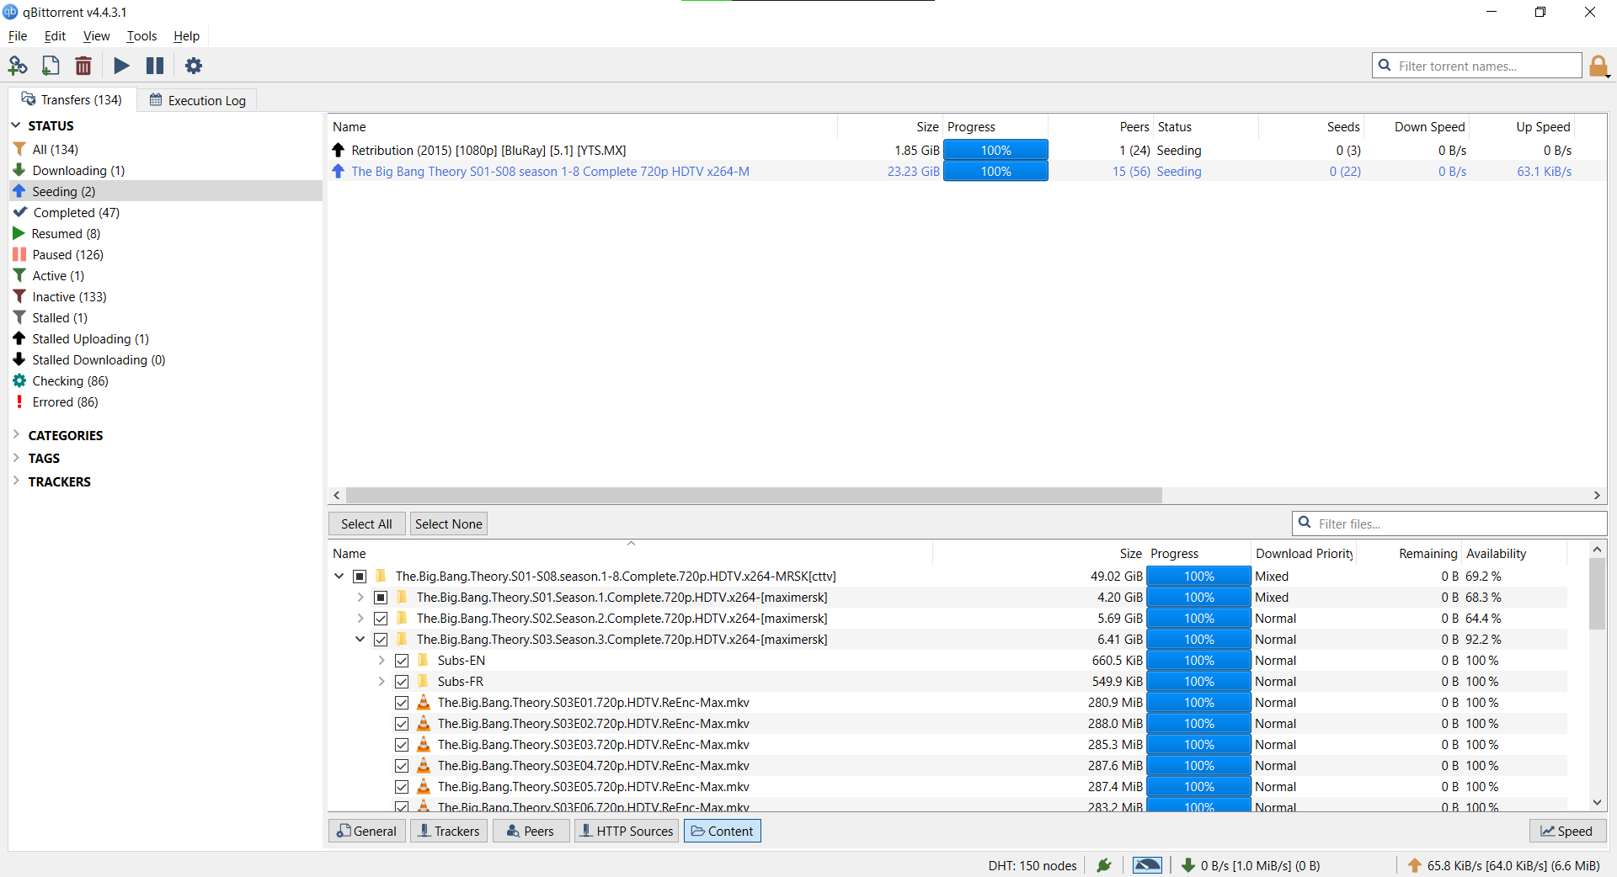

Slide 25
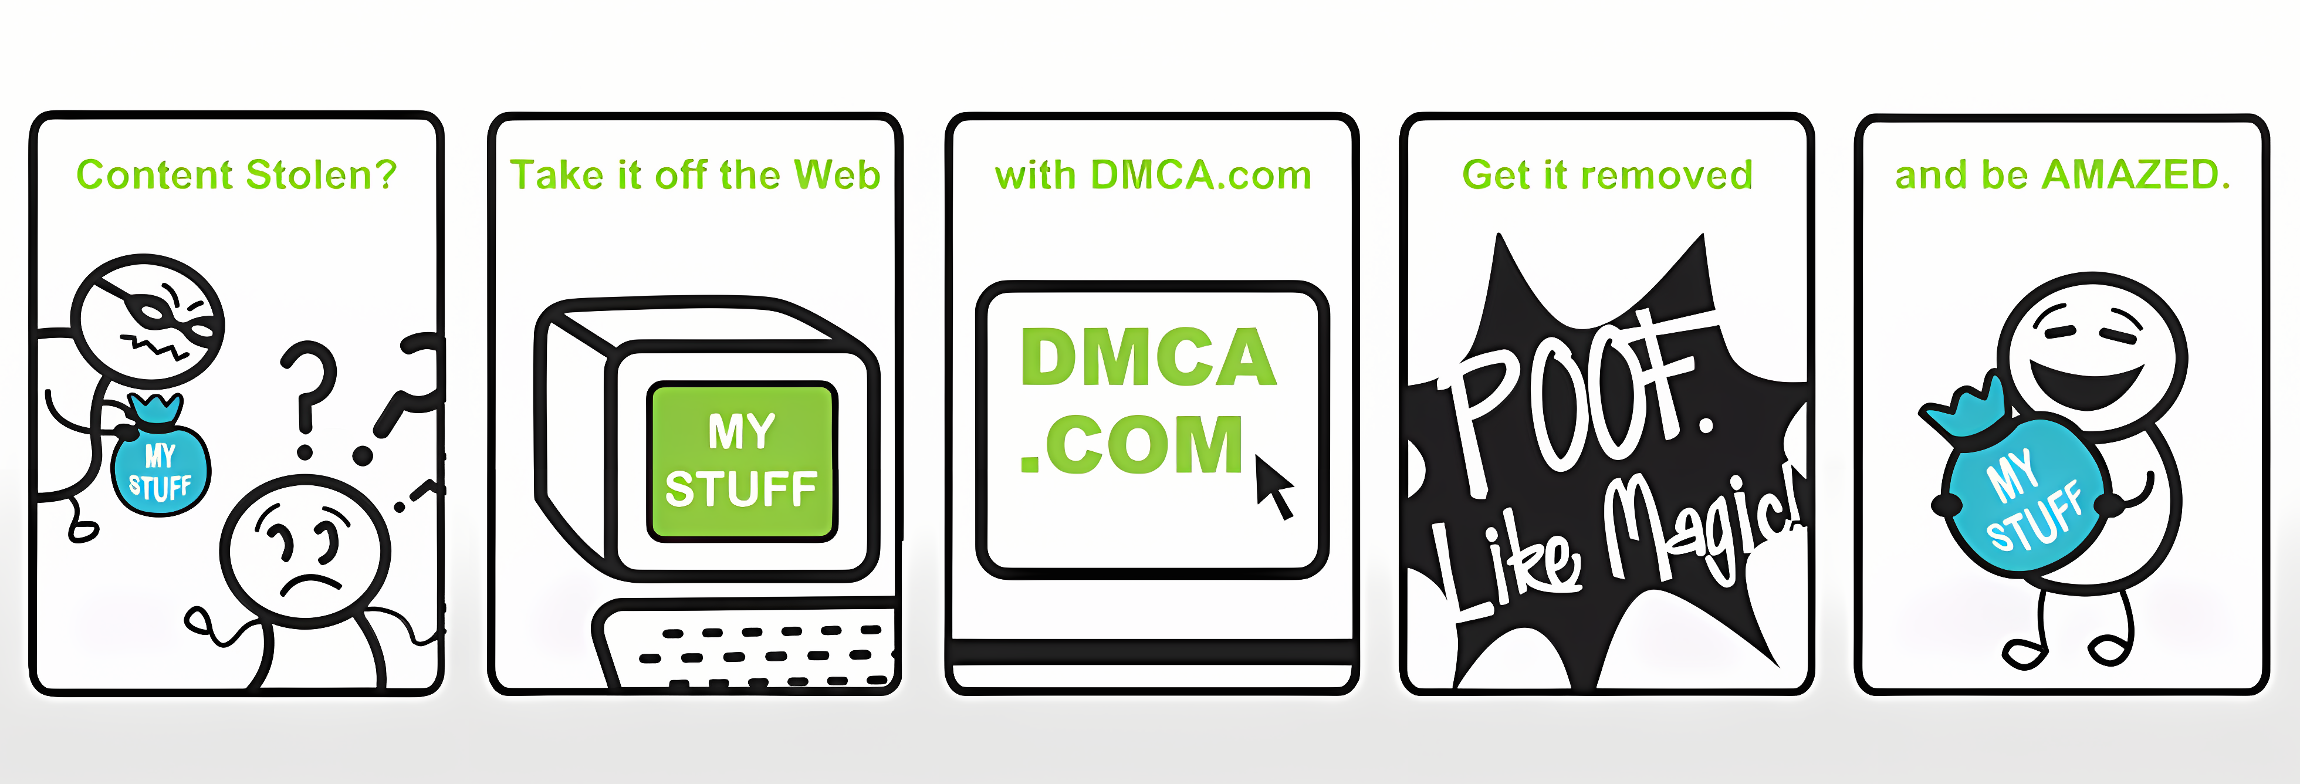
The goddamn DMCA
It all goes to the publishers, not creators!

Slide 26

It is a war behind the scene
Gottfrid Svartholm

Slide 27
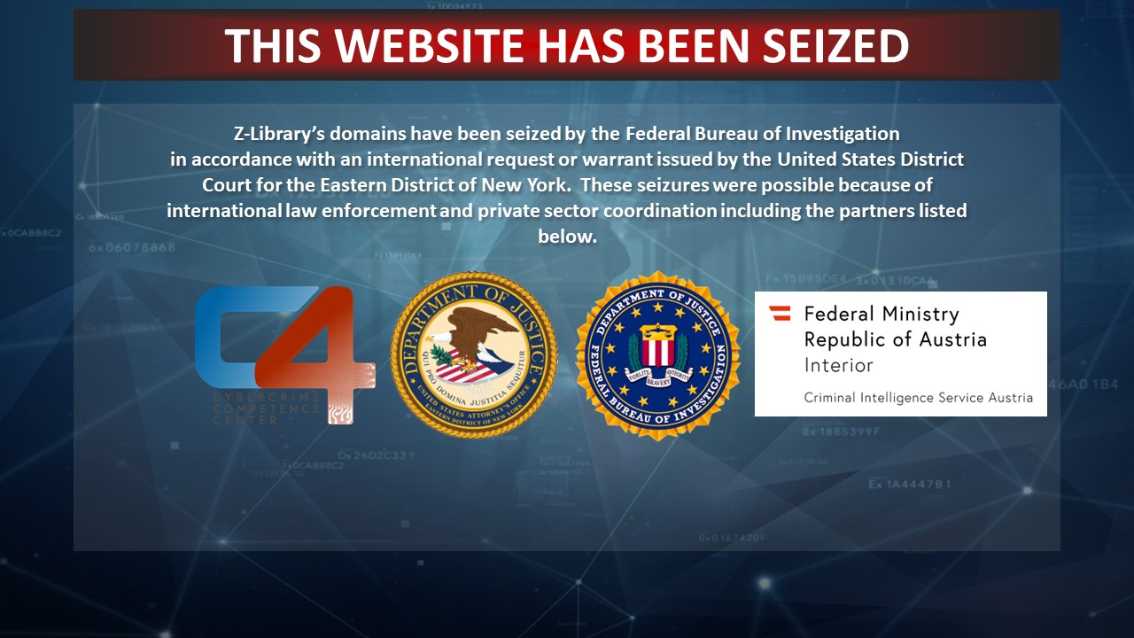

Slide 28
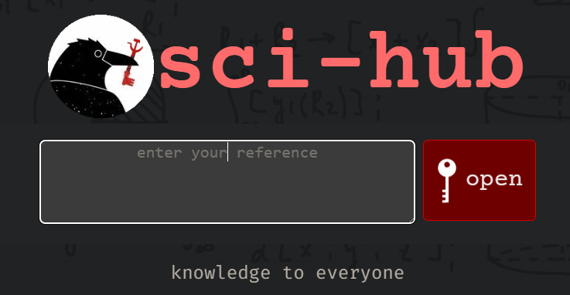

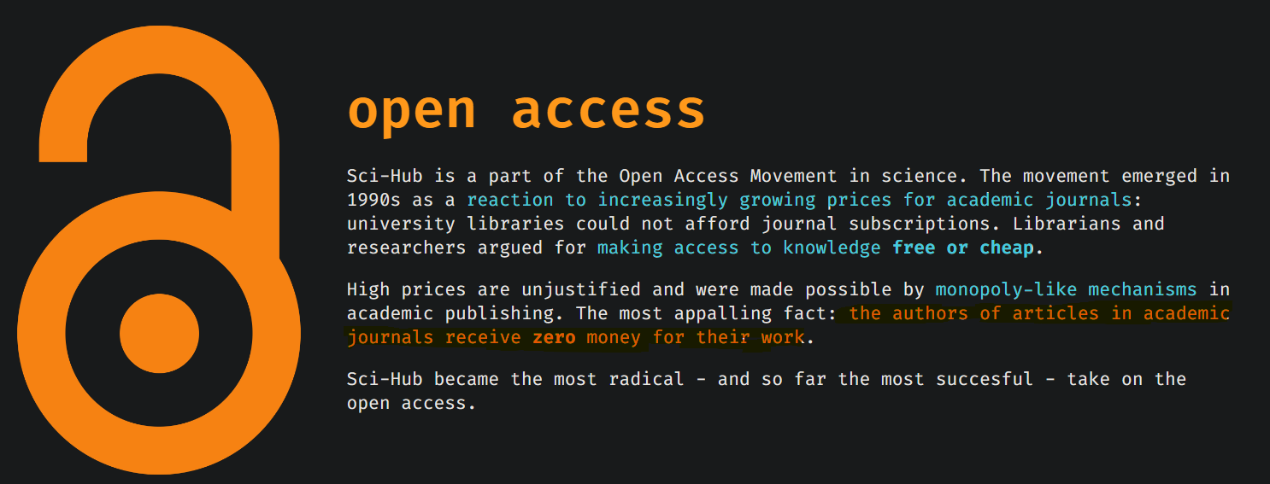
Alexandra Elbakyan

Slide 29
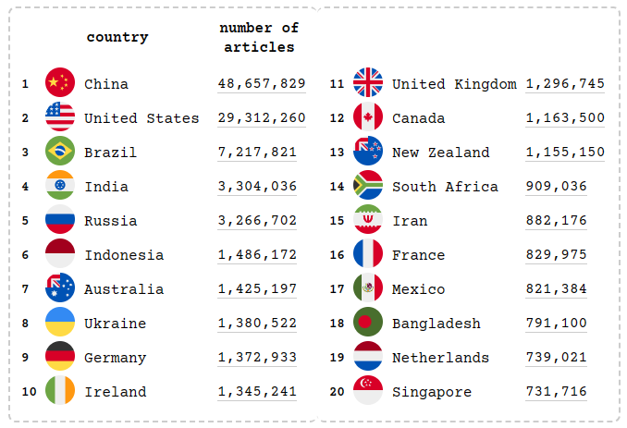
The table shows countries that downloaded most papers from Sci-Hub in the last month, ordered by number of downloads.

Slide 30
Practical Examples
Sci-Hub: already introduced
Anna’s archive: replacement for Z-library
NewPipe, Revanced, and ReturnYouTubeDislike: “fix” YouTube
Media:
TorrentGalaxy: Movies, games, software, music, TV series, etc.
Fmovies: Replacement for all streaming services (video)
Moderated and verified wikis and resources:
r/piracy
r/piracy megathread
4chan

Slide 31
Practical Examples

Slide 32
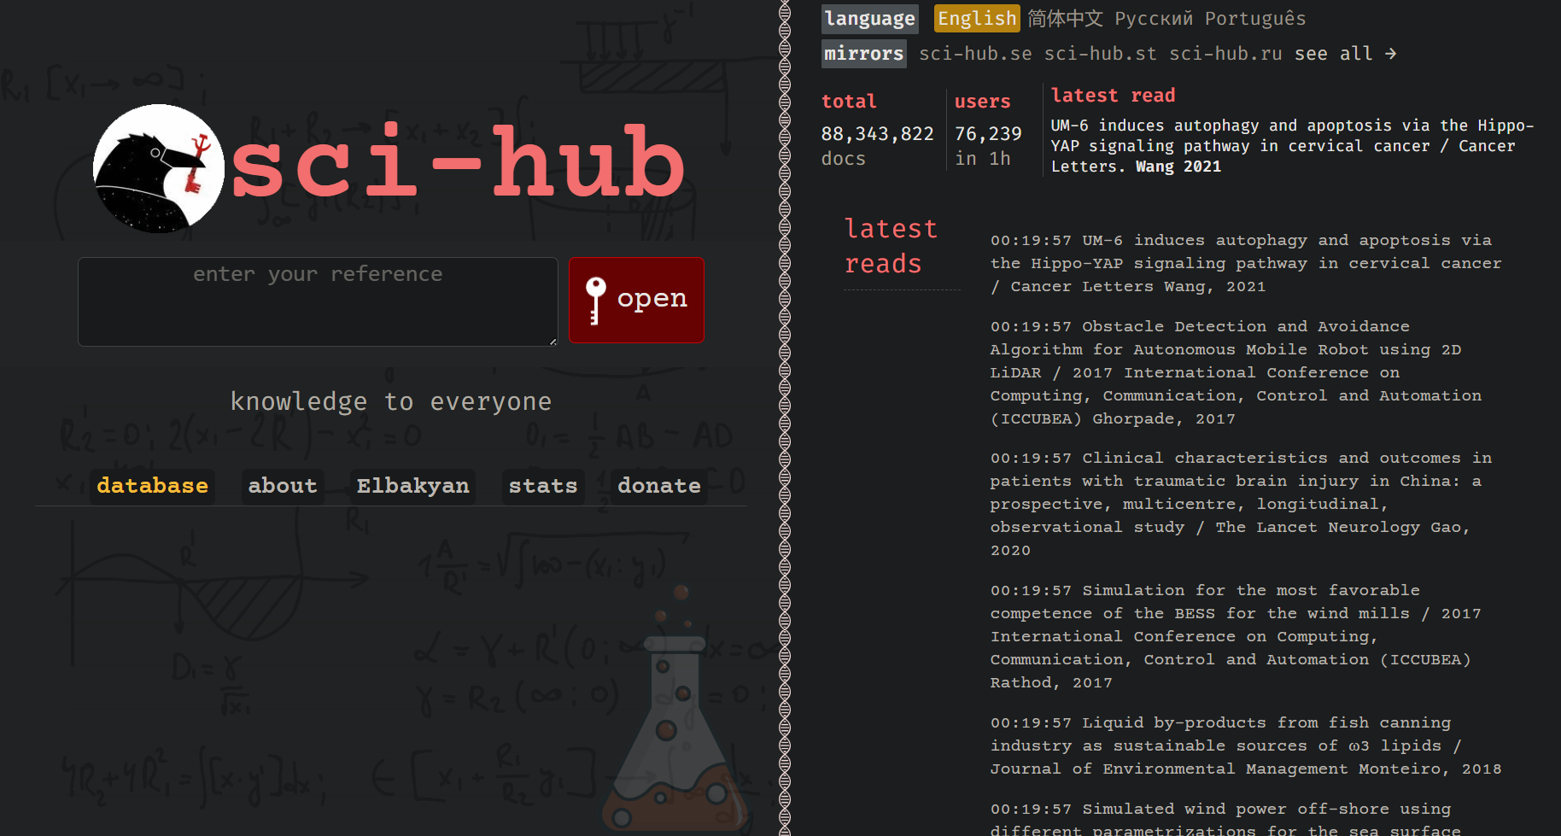

Slide 33
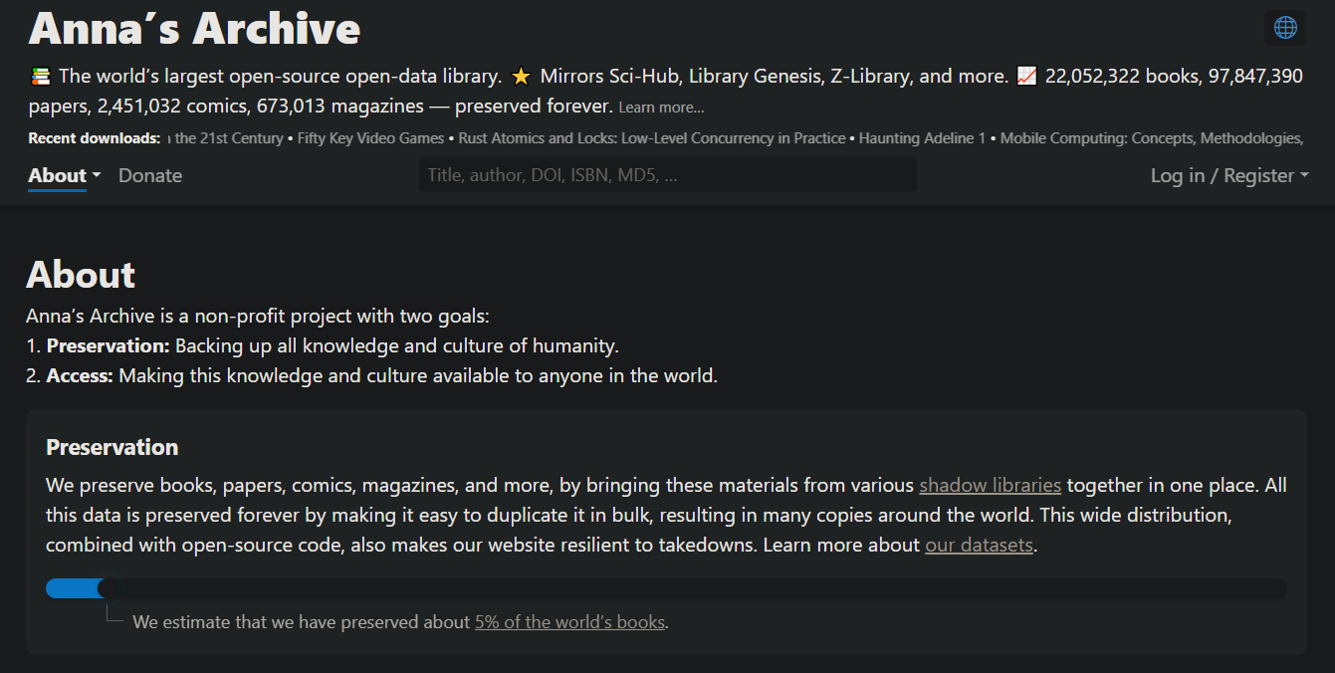

Slide 34
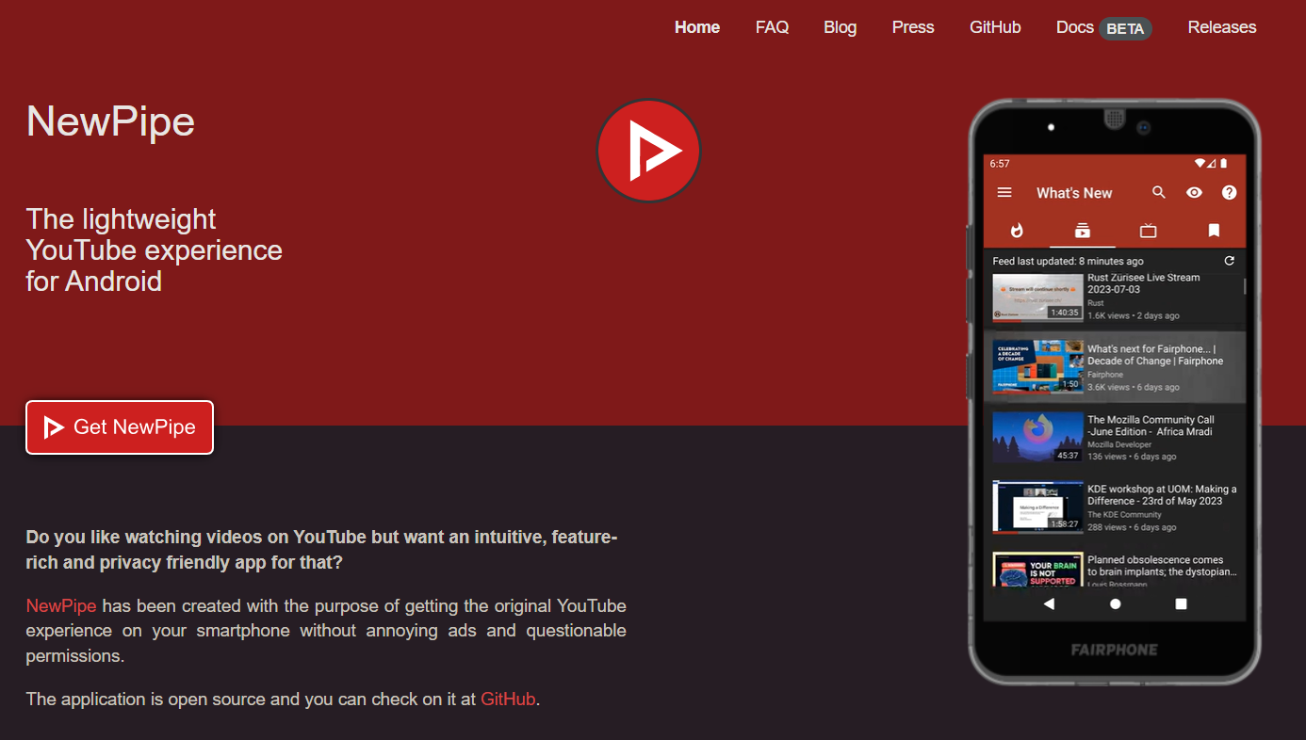

Slide 35
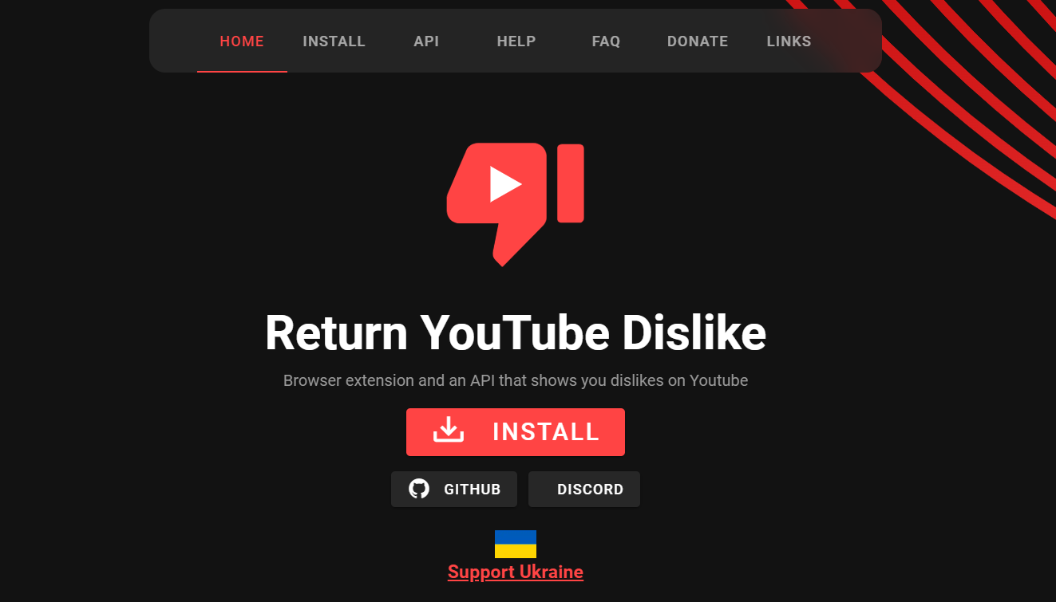

Slide 36
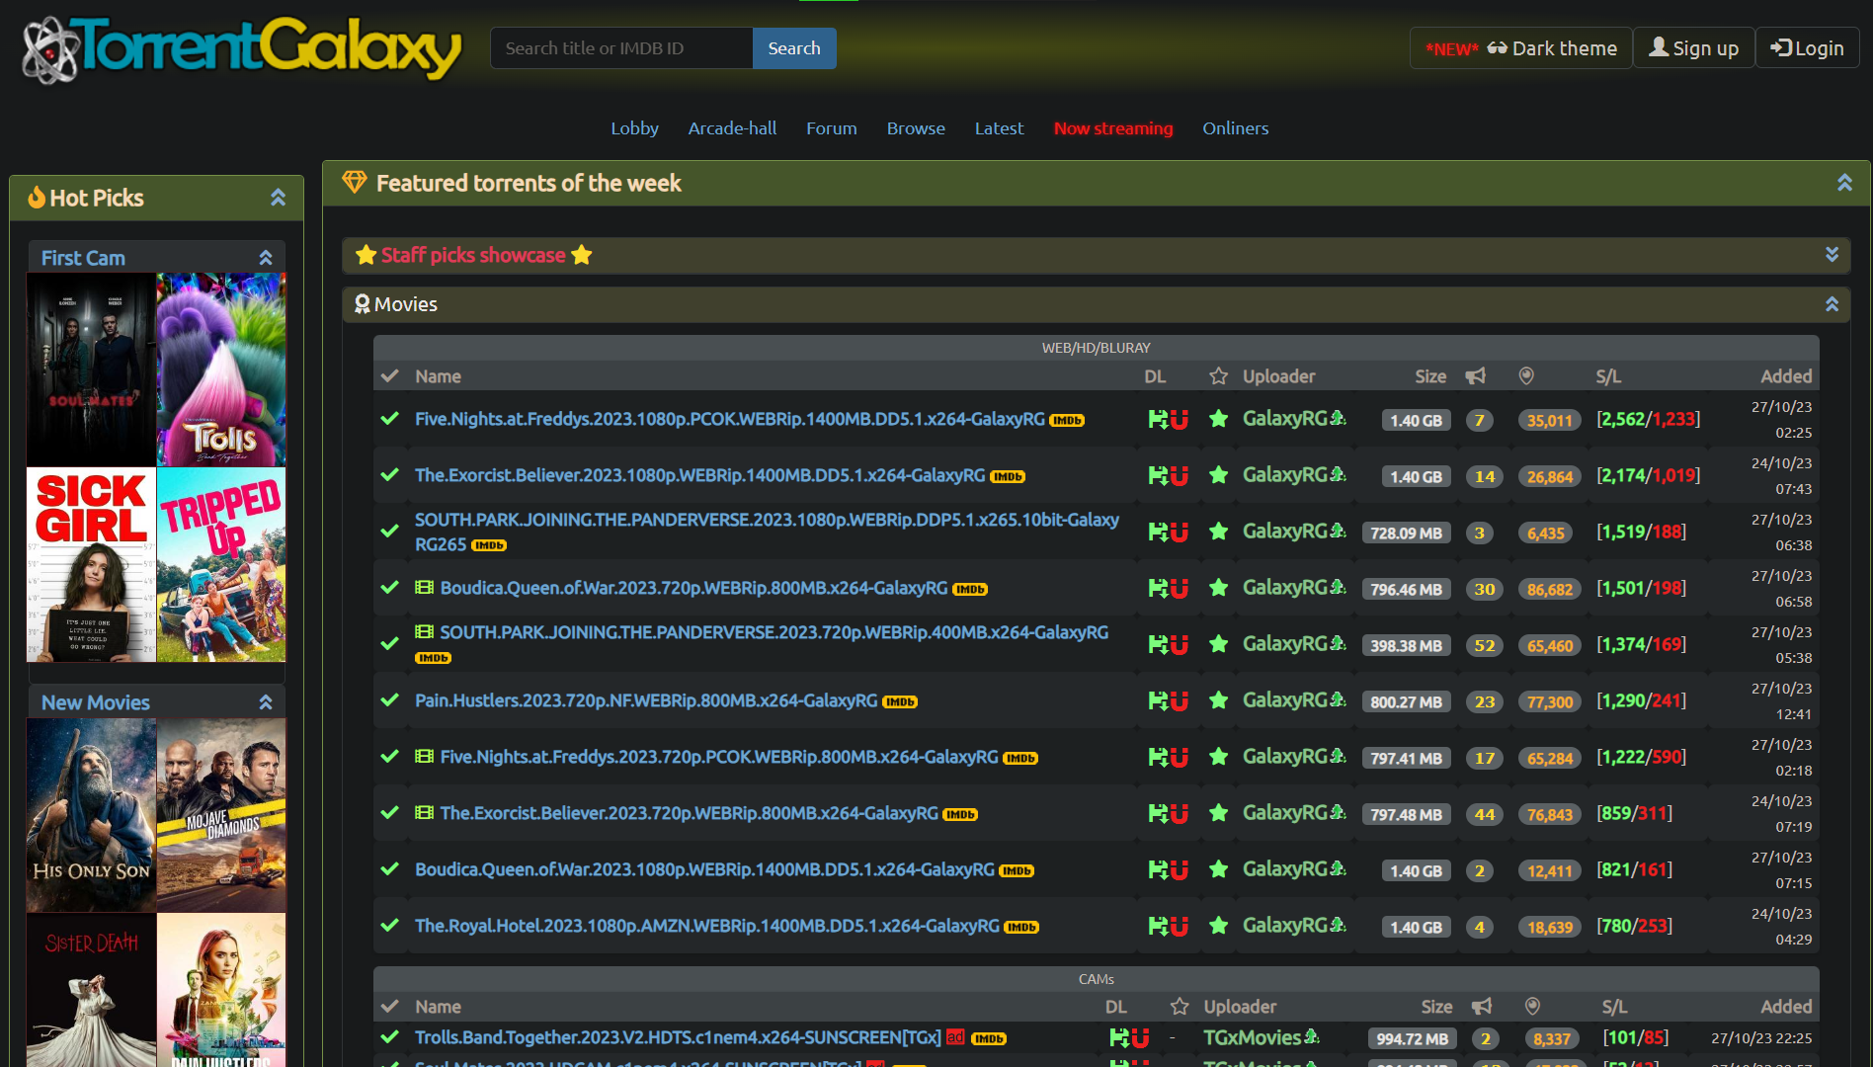

Slide 37
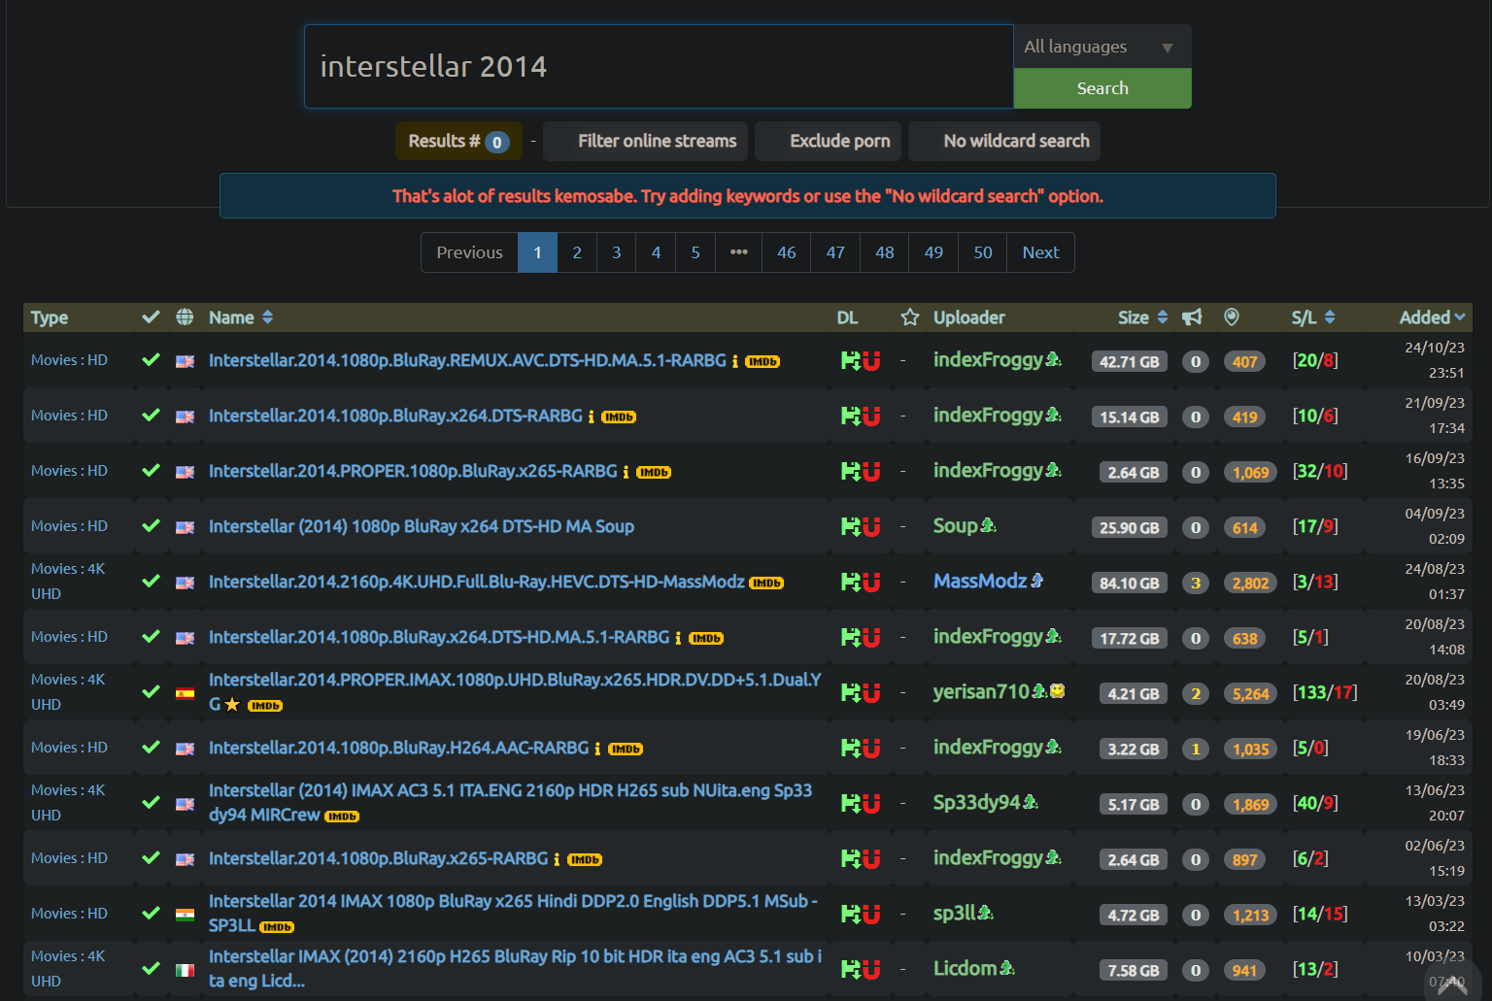

Slide 38
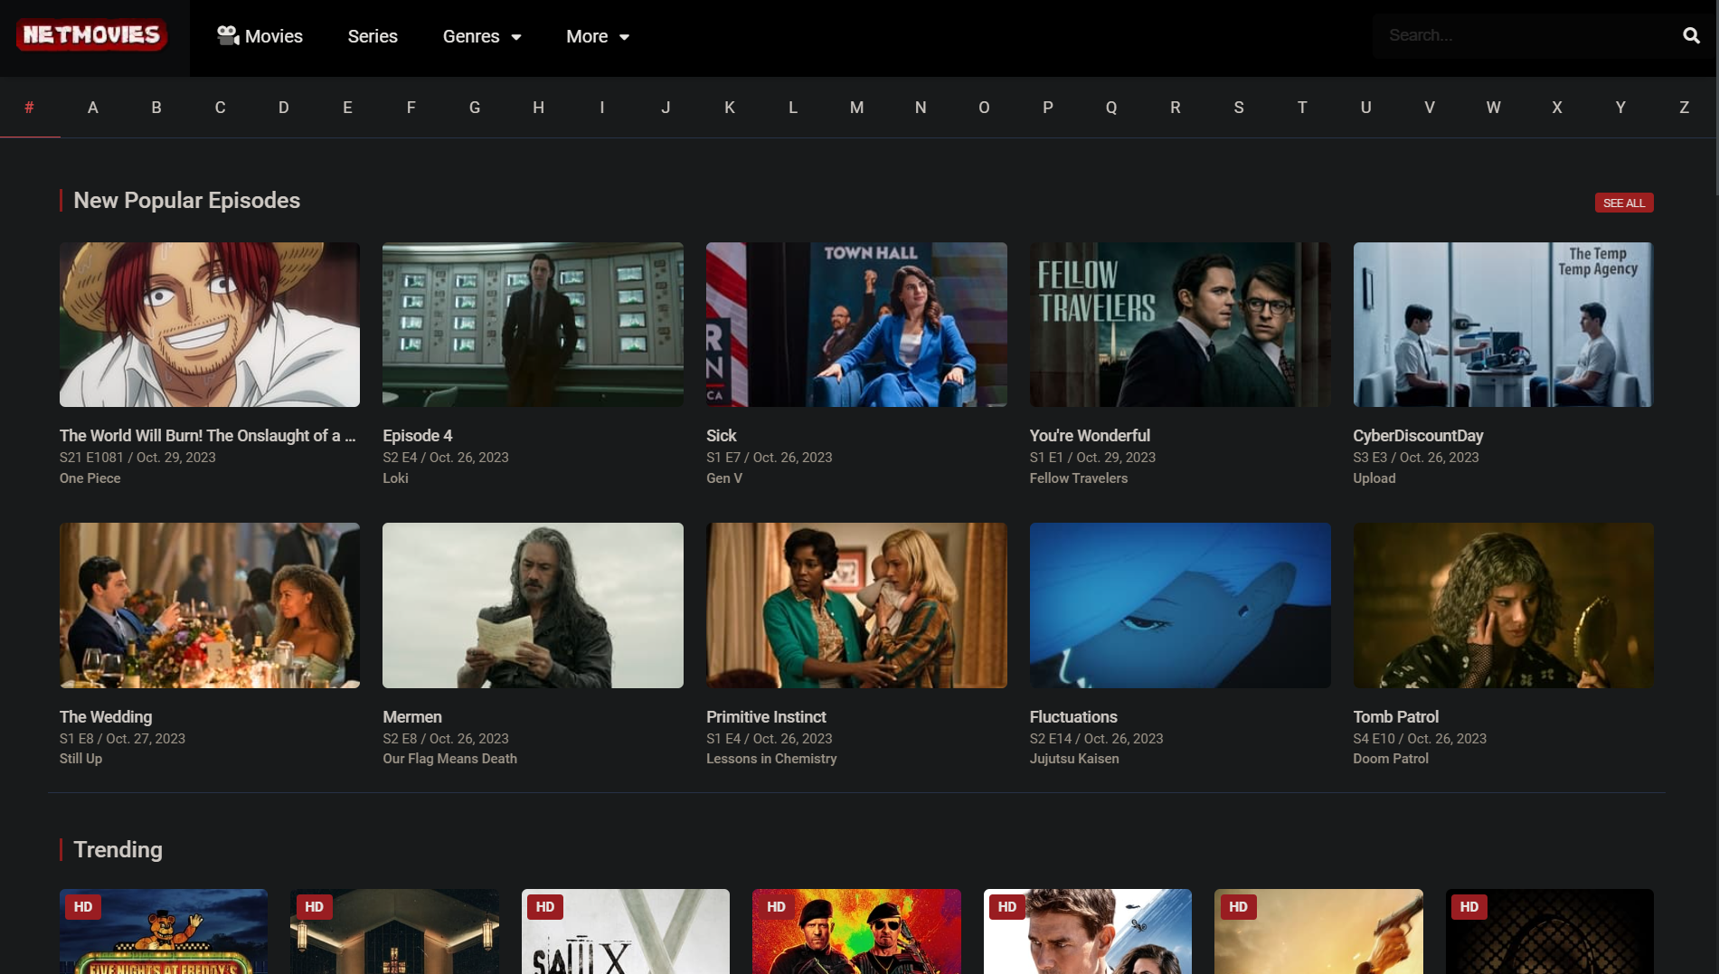

Slide 39
Last Thoughts

Slide 40
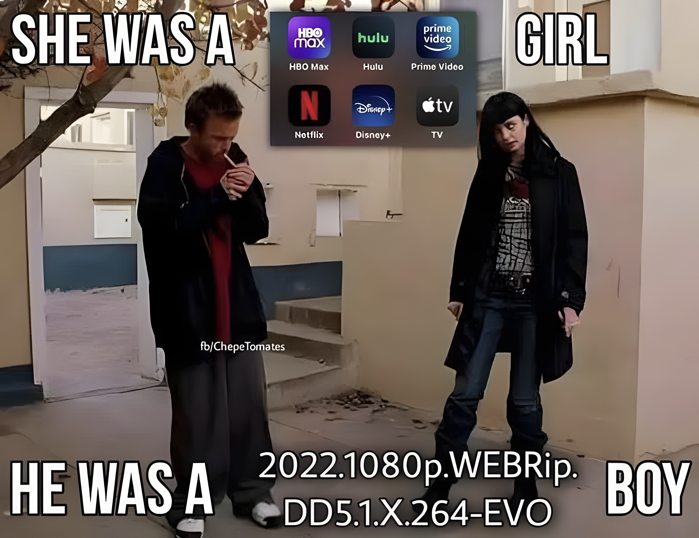
You might look like a creep for “over”-complicating stuff

Slide 41
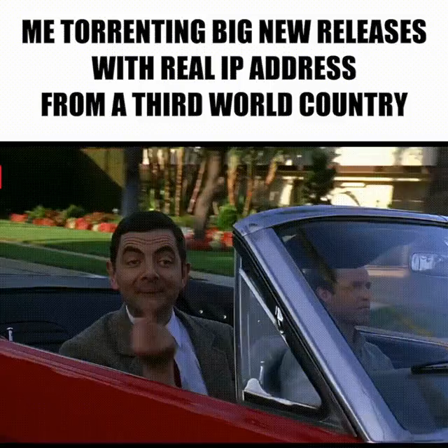
We as Iranians, for just the sake of censorship and not being affected by DMCA, should use it

Slide 42
It is a “people for the people” fight; please provide as much as you consume; SEED the torrents

Slide 43
Thank you

